Slide 1
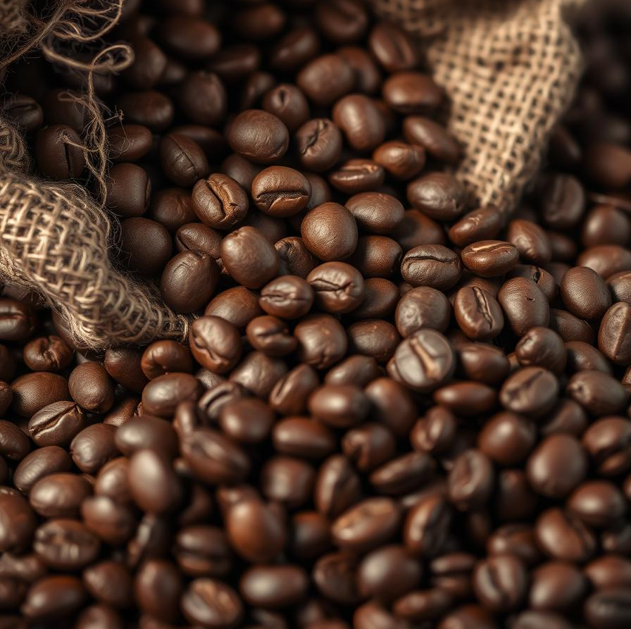
Coffee

Slide 2
Presented by:
Mohamed Ahmed
Omar Mokhtar
Mohamed Kamal
Mustafa Waheed
Mostafa Hamed

Slide 3
Table of Content
Introduction
Origins of Coffee
What is Coffee and what does it do ?
Coffee’s cultural significance and uses
Conclusion
Table Contents

Slide 4

Coffee in Our Daily Lives
Coffee is more than just a drink; it's a global phenomenon. Billions of cups are enjoyed daily, fueling economies worldwide.
It’s a huge industry, with most Americans enjoying it every day. Coffee has truly become an integral part of our routines.

Slide 5
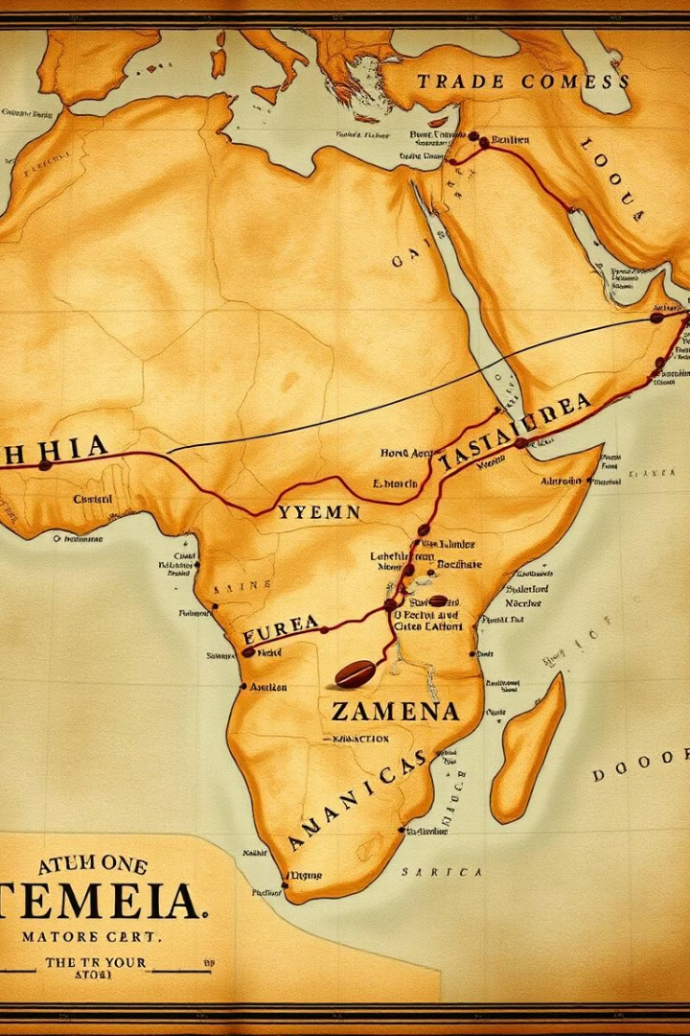
The Origins of Coffee
1
Ethiopian Discovery
Kaldi, a goat herder, discovered coffee around 850 AD.
2
Yemen Cultivation
Sufi monks first cultivated coffee in Yemen in the 15th century.
3
Global Spread
Coffee spread to the Ottoman Empire, then Europe via trade routes.
4
Arrival in Americas
It was introduced to the Americas in the early 18th century.

Slide 6
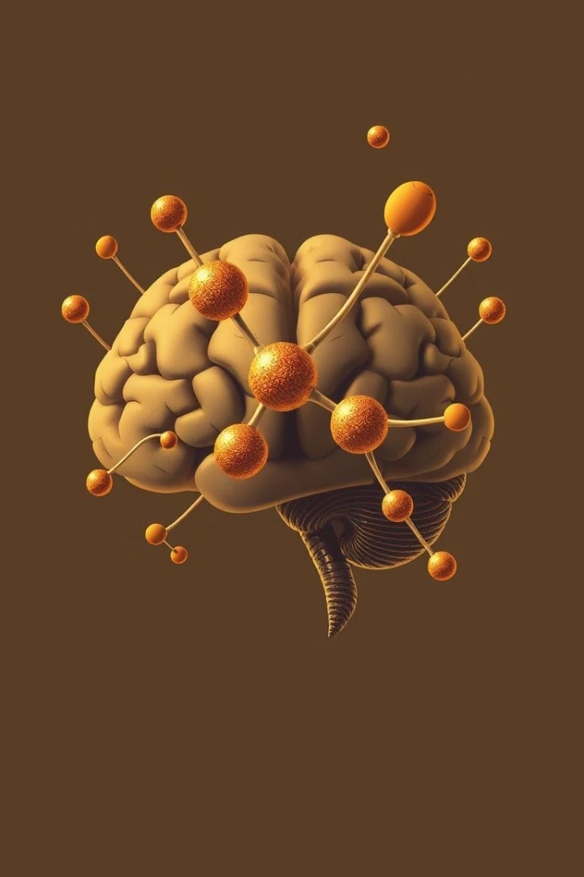




What is Caffeine and What Does It Do?
Natural Stimulant
Caffeine is an alkaloid found in coffee beans.
Blocks Adenosine
It blocks the sleep-promoting neurotransmitter, adenosine.
Peak Effects
Effects peak in 30-60 minutes, with a 5-hour half-life.
Enhances Focus
It boosts alertness, focus, and mood.

Slide 7





Beyond Caffeine: Coffee's Hidden Benefits
Rich in Antioxidants
Coffee contains polyphenols and hydrocinnamic acids.
Diabetes Protection
Chlorogenic acid may reduce type 2 diabetes risk.
Essential Nutrients
It provides Riboflavin, Niacin, Magnesium, and Potassium.
Neuroprotective
May protect against Parkinson's and Alzheimer's diseases.

Slide 8

A Global Ritual: Coffee's Cultural Significance
Viennese Coffeehouses
Swedish Fika
Italian Espresso
Centers for intellectual discussion in the 17th century.
A daily coffee break for social connection and relaxation.
A short, strong, social drink, often consumed standing.

Slide 9
Common Uses of Coffee Today
Morning Ritual
Social Lubricant
Culinary Ingredient
Medicinal Use
Primary beverage for energy and wakefulness.
Used for meetings, dates, and casual gatherings.
Key in desserts, marinades, and flavorings.
Found in some OTC medications for alertness.

Slide 10

The Economic and Environmental Footprint
25M+
1st
3
Farmers Supported
Traded Commodity
Environmental Concerns
Livelihoods supported globally.
One of the most traded commodities.
Deforestation, water usage, pesticides.
1
Fair Trade
Ensures sustainable practices and wages.

Slide 11

Conclusion: The Enduring Power of Coffee
Daily Cornerstone
Integral to routines, culture, and economies.
Rich Importance
History, chemistry, and diverse uses are key.
Shaping Future
Innovation and sustainability guide its path.
Beyond Beverage
Connects communities, fuels daily life.

